Slide 1
Hispanic Americans

Slide 2
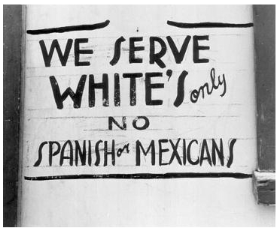
Circumstances…
What led to the Hispanic American Civil Rights Movement?
Latinos experience discrimination and segregation…
Latino students were routinely punished for speaking Spanish on school property, not allowed to use the bathroom during lunch, and actively discouraged from going to college.

Slide 3
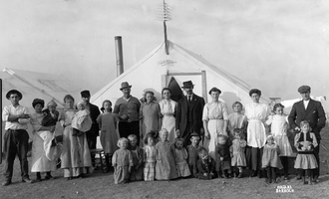
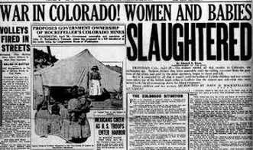
Circumstances…
What led to the Hispanic American Civil Rights Movement?
The Ludlow Massacre
was an attack by the Colorado National Guard on coal miners who were on a strike for better working conditions.
More than 50 people were killed, mostly Mexican Americans, including 11 children and three women.

Slide 4
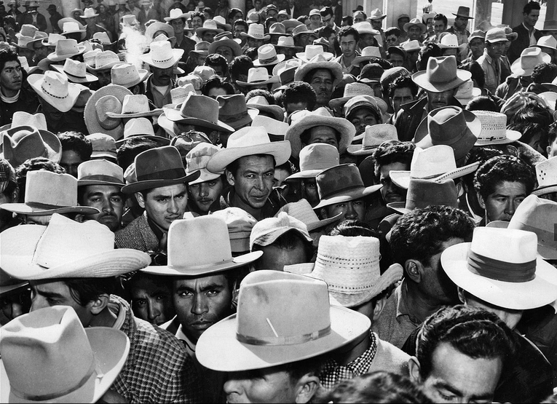
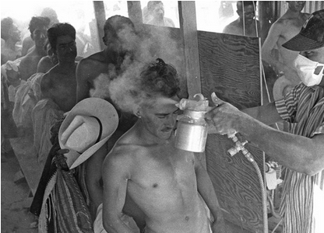
Circumstances…
What led to the Hispanic American Civil Rights Movement?
The Bracero Program brings Mexican citizens to work temporarily in the United States.
Upon arrival to the in inspection centers, US officials sprayed them with DDT, a dangerous insecticide that is now banned.

Slide 5
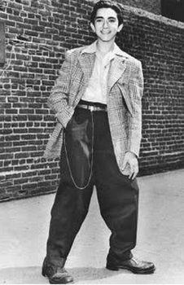
Circumstances…
What led to the Hispanic American Civil Rights Movement?
The Zoot Suit Riots, are the worst race riots in California.
American sailors searched Mexican American neighborhoods for "zoot-suiters" (young Mexican teens dressed in baggy pants and long-tailed coats).
kids as young as 12 years old are brutally beaten.

Slide 6
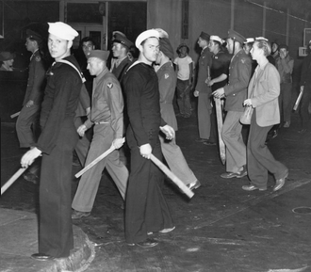
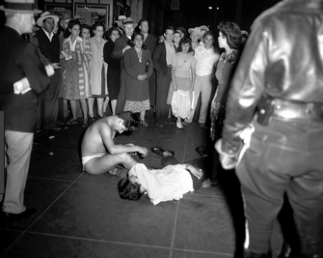

Slide 7
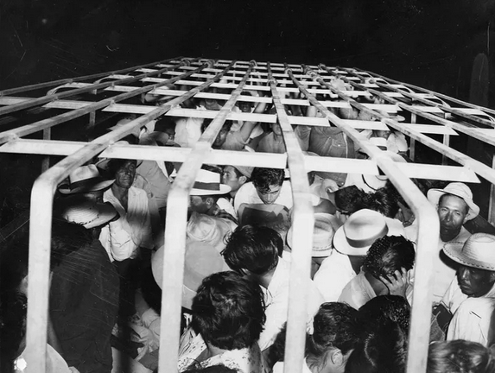
Circumstances…
What led to the Hispanic American Civil Rights Movement?
During "Operation Wetback" from 1953 and 1958, the U.S. Immigration Service arrests and deports more than 3.8 million Latin Americans.
The U.S. Border Patrol packed Mexican immigrants into trucks when transporting them to the border for deportation.

Slide 8
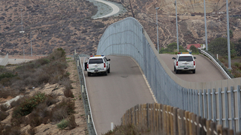
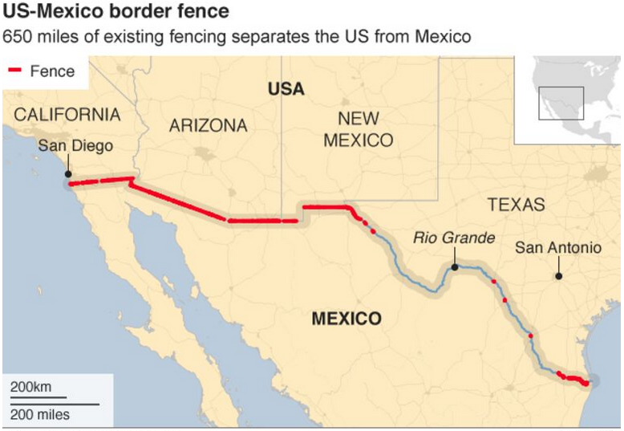
Circumstances…
What led to the Hispanic American Civil Rights Movement?
After the terrorist attacks of 9/11 fears over "border security," increase. Some politicians begin to ask for building a wall between the United States and Mexico. This leads to increase discrimination against Latino immigrants.

Slide 9
Goal…
to advance the economic, political, housing opportunities and civil rights of Hispanic Americans.

Slide 10
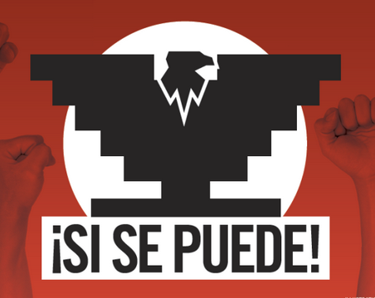
Methods to achieve change…

Slide 11
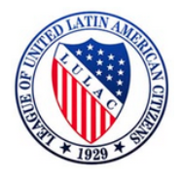
Methods to achieve change…
How did Hispanic American fight to gain Civil Rights?
the League of United Latin American Citizens (LULAC). The group organizes against discrimination and segregation and promotes education among Latinos. It's the largest and longest-lasting Latino civil rights group in the country.

Slide 12
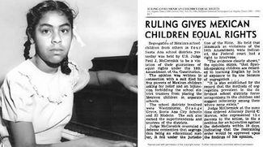
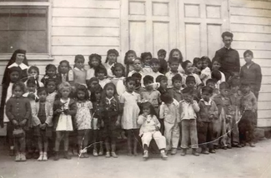
Methods to achieve change…
How did Hispanic American fight to gain Civil Rights?
Mexican-American parents sue several California schools, challenging the segregation of Latino students in separate schools.
The California Supreme Court rules in the parents' favor in Mendez v. Westminster, arguing segregation violates children's constitutional rights.

Slide 13
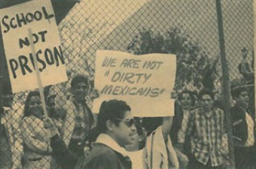
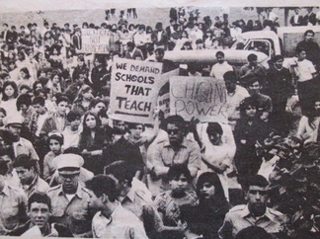
Methods to achieve change…
How did Hispanic American fight to gain Civil Rights?
Latino high school students in Los Angeles stage citywide walkouts protesting unequal treatment by the school district.
Walkout participants are subjected to police brutality and 13 are arrested on charges of disorderly conduct.

Slide 14
Methods to achieve change…
How did Hispanic American fight to gain Civil Rights?
Cesar Chavez and Dolores Huerta found the United Farm Workers Union, which becomes the largest and most important farm worker union in the nation.

Slide 15
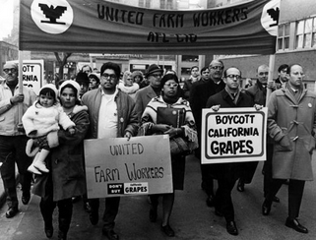
Methods to achieve change…
How did Hispanic American fight to gain Civil Rights?
The Grape Boycott becomes one of the most significant social justice movements for farm workers in the United States.
To bring attention to the boycott, Chavez had a 25 day fast (did not eat).
By 1970, the grape boycott was a success. Employers signed union contracts, giving workers better conditions and pay.

Slide 16
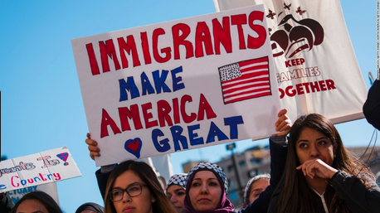
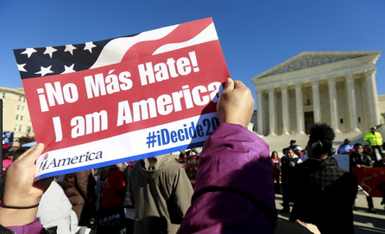
Methods to achieve change…
How did Hispanic American fight to gain Civil Rights?
On May 1, hundreds of thousands of Latino immigrants and others participate in the Day Without Immigrants, boycotting work, school and shopping, to symbolize the important contributions immigrants make to the American economy.

Slide 17
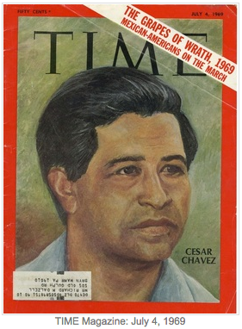
Notable People…

Slide 18
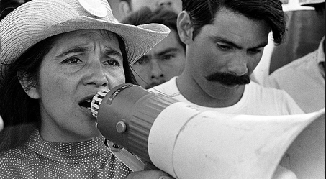
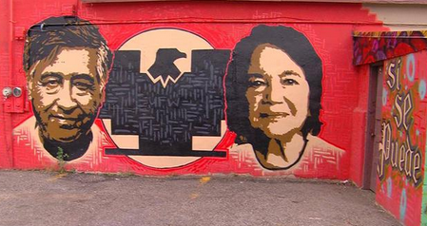
Notable People…
Who was instrumental in helping Hispanic Americans gain Civil Rights?
Cesar Chavez and Dolores Huerta found the United Farm Workers association

Slide 19
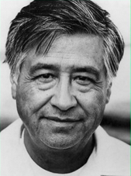
Cesar Chavez has become an icon for organized labor and for Hispanic empowerment. He is also famous for popularizing the slogan "Sí, se puede" (Spanish for "Yes, one can" or, roughly, "Yes, it can be done"), which was adopted as the 2008 campaign slogan of Barack Obama.

Slide 20
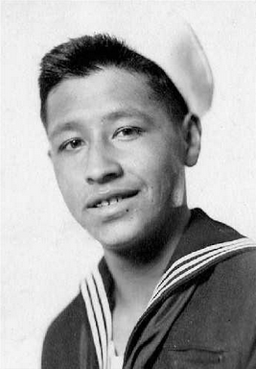
Cesar Chavez was born in 1927 in Arizona.
His grandfather was a runaway slave who emigrated from Mexico to Texas.
Cesar’s family worked hard on their 100 acre family farm but the family lost their farm during the Great Depression, and became migrant workers who followed crops to find work.
Cesar attended 65 different elementary schools.
At 16, Cesar joined the US navy during World War 2.
After the war, Cesar worked all day in the field with his family. He watched farm owners take advantage of their workers.
16 year old Cesar Chavez in the Navy ca.1946

Slide 21
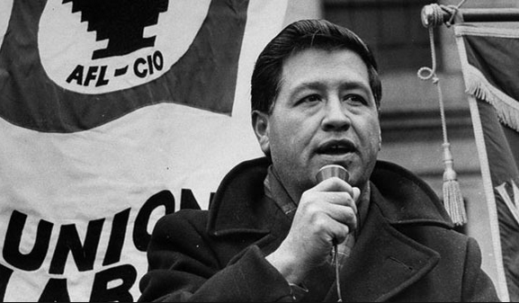
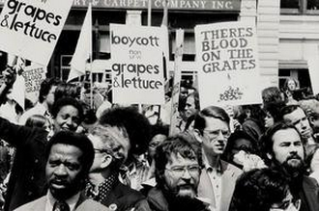
Cesar picked fruit all day and registered Mexican workers to vote at night. In 1962, he organized the United Farm Workers of America.
When farm owners ignored their requests for better pay and safe working conditions, the union held a 5 year strike and nation- wide grape boycott.
Strikers lost their jobs, were beaten, and even thrown in jail.
Union members fasted and marched miles to make demands known to citizens.
Grape growers lost millions of dollars as the boycott spread across America.
Soon after the boycott lawmakers supported the farm worker union struggle and laws changed and working conditions improved. The UFW union keeps fighting for their rights today.

Slide 22
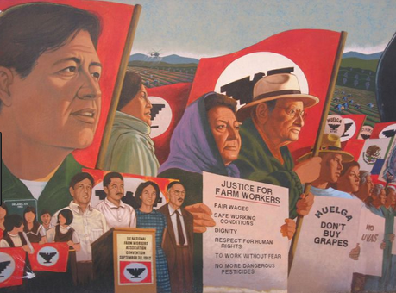

Slide 24
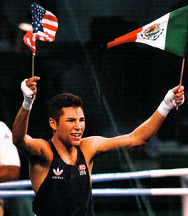
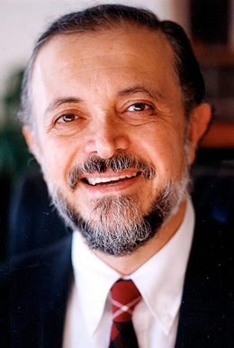
Notable People…
Who was instrumental in helping Hispanic Americans gain Civil Rights?
Oscar De La Hoya
Boxing Champ
Known as the "golden boy” since his 1992 Olympic gold win. After retiring from active boxing, he has remained a powerful presence in the sport through his company, Golden Boy Promotions.
Mario J. Molina scientist
Corecipient of the Nobel Prize in chemistry in 1995 for his research on the effects of chlorofluorocarbons on the ozone layer, he was awarded the Presidential Medal of Freedom in 2013.

Slide 25
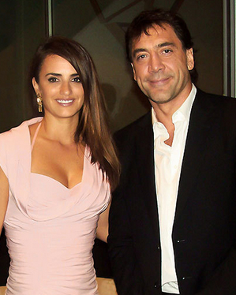
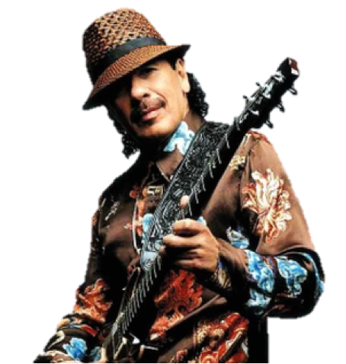
Notable People…
Who was instrumental in helping Hispanic Americans gain Civil Rights?
Penélope Cruz and Javier Bardem actors
The actors are the only Spanish actors to have won Oscars
Carlos Santana musician
Born in Mexico, this guitar virtuoso moved to San Francisco in 1961, where he developed his distinctive style of rock fused with Latin, jazz and blues. Inducted into the Rock and Roll Hall of Fame, this humanitarian and social activist has sold more than 90 million records and has 10 Grammys and three Latin Grammys.

Slide 26
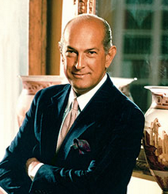
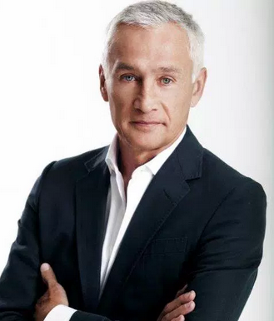
Notable People…
Who was instrumental in helping Hispanic Americans gain Civil Rights?
Oscar de la Renta
fashion designer
Dominican-American fashion designer. He became internationally known in the 1960s as one of the couturiers who dressed Jacqueline Kennedy. His has boutiques around the world including in Harrods of London and Madison Avenue,New York.
Jorge Ramos
Journalist and TV Anchor
One of the most recognizable faces in Spanish-speaking America, he has anchored Noticiero Univision, Univision’s top-rated national newscast, since 1986, and has hosted a weekly news show, Al Punto, since 2007. Born in Mexico City, he has penned 11 books; his accolades include eight Emmy Awards, the Maria Moors Cabot Award and the David Brinkley Award for Journalistic Excellence.

Slide 27
Reforms…

Slide 28
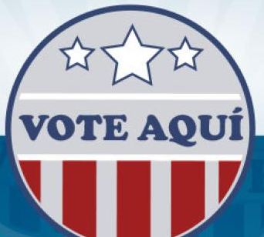
Reforms…
How did Hispanic Americans gain Civil Rights?
The Equal Educational Opportunity Act of 1974 makes bilingual education more widely available in public schools.
Congress votes to expand the U.S. Voting Rights Act to require language assistance at polling stations

Slide 29
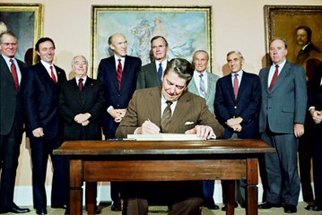
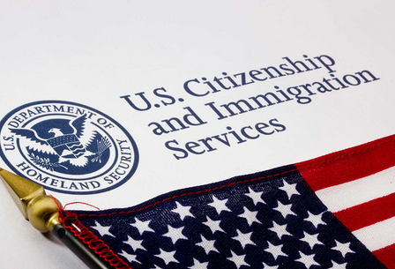
Reforms…
How did Hispanic Americans gain Civil Rights?
The Immigration Reform and Control Act (IRCA), providing legalization for certain undocumented workers, including agricultural workers.

Slide 30
Next Steps…

Slide 31
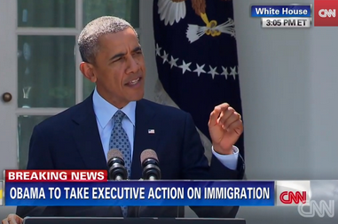
Next Steps…
What else is needed for Hispanic Americans to gain Civil Rights?
President Barack Obama issues an Executive Order protecting up to 5 million undocumented immigrants from deportation.
Several states oppose the order and in 2016
the Supreme
Court blocks
the order.

Slide 32
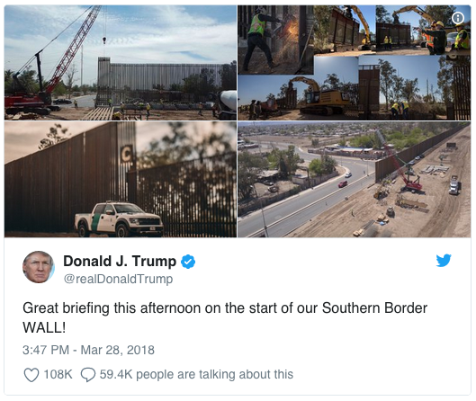
Next Steps…
What else is needed for Hispanic Americans to gain Civil Rights?
President Donald Trump issues an Executive Order to start a travel ban of refugees and immigrants from 7 Muslim countries. The Order also includes a provision to build a border Wall between US and Mexico.
The Supreme Court blocks Trump’s travel ban but his plans to build the border wall are still on the way…

Slide 33
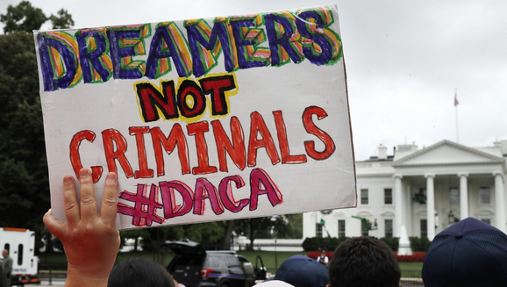
Next Steps…
What else is needed for Hispanic Americans to gain Civil Rights?
The Trump administration ended DACA, a program that had protected nearly 800,000 young illegal immigrants brought to the US as children from deportation.
In the five years since DACA was enacted, the nearly 800,000 individuals who have received the protections have started families, pursued careers and studied in schools and universities across the United States are now in danger of being deported.

